Slide 1
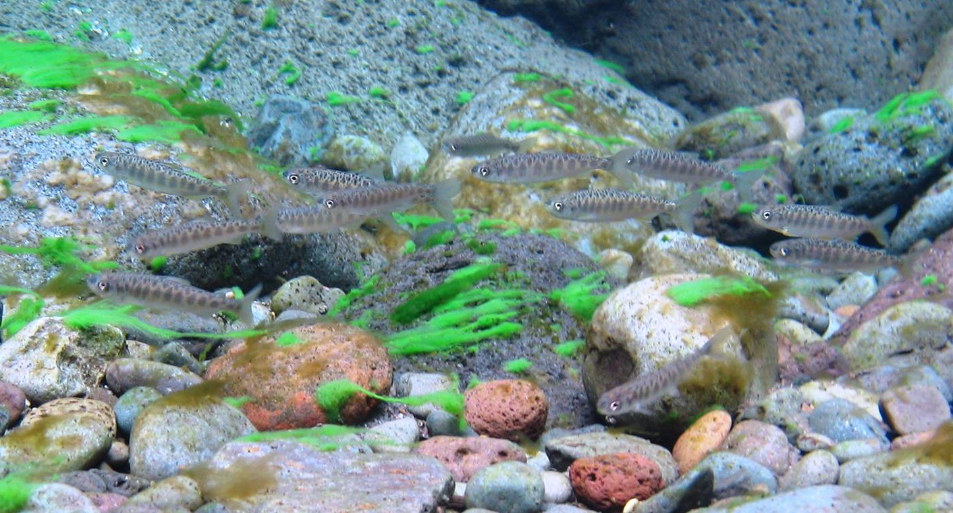
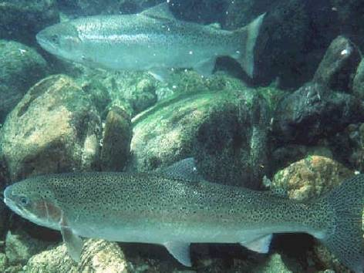
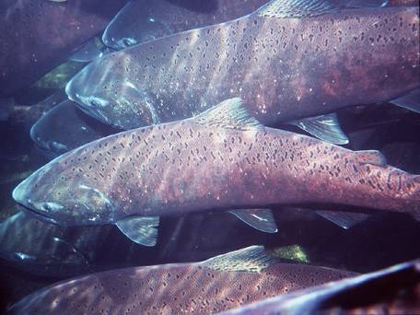
North Santiam Temperature Task Group W-FPOM
October 26, 2016

Slide 2
North Santiam Temperature Targets Current vs. Proposed
Notes:
ESA, BiOp, RPA, late, not much pressure, more interest lately

Slide 3
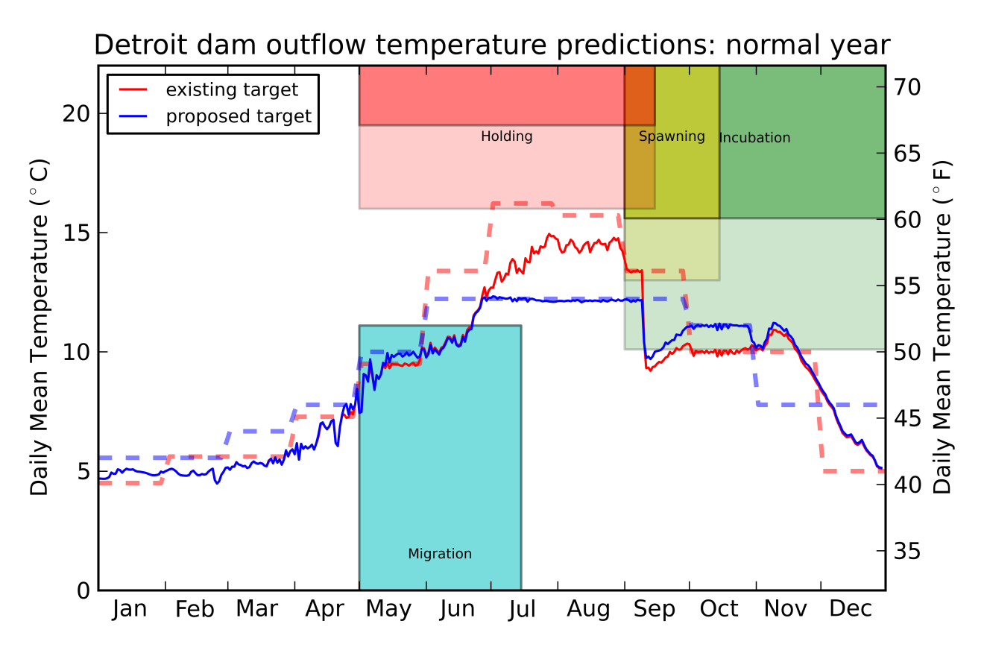
Normal Year

Slide 4
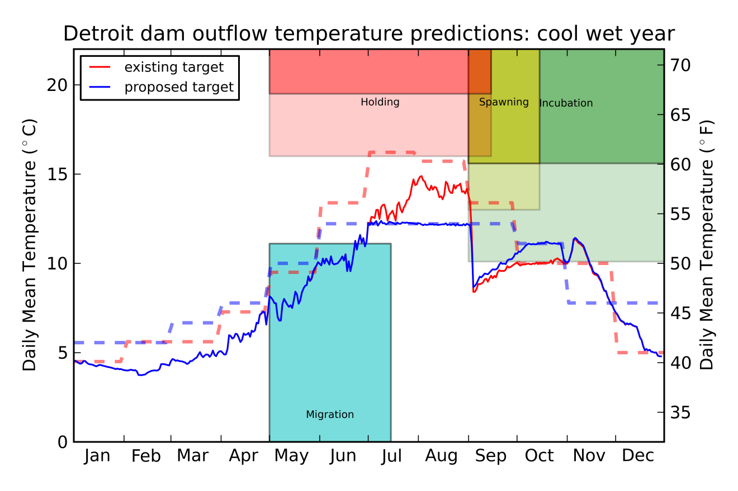
Cool Wet Year

Slide 5
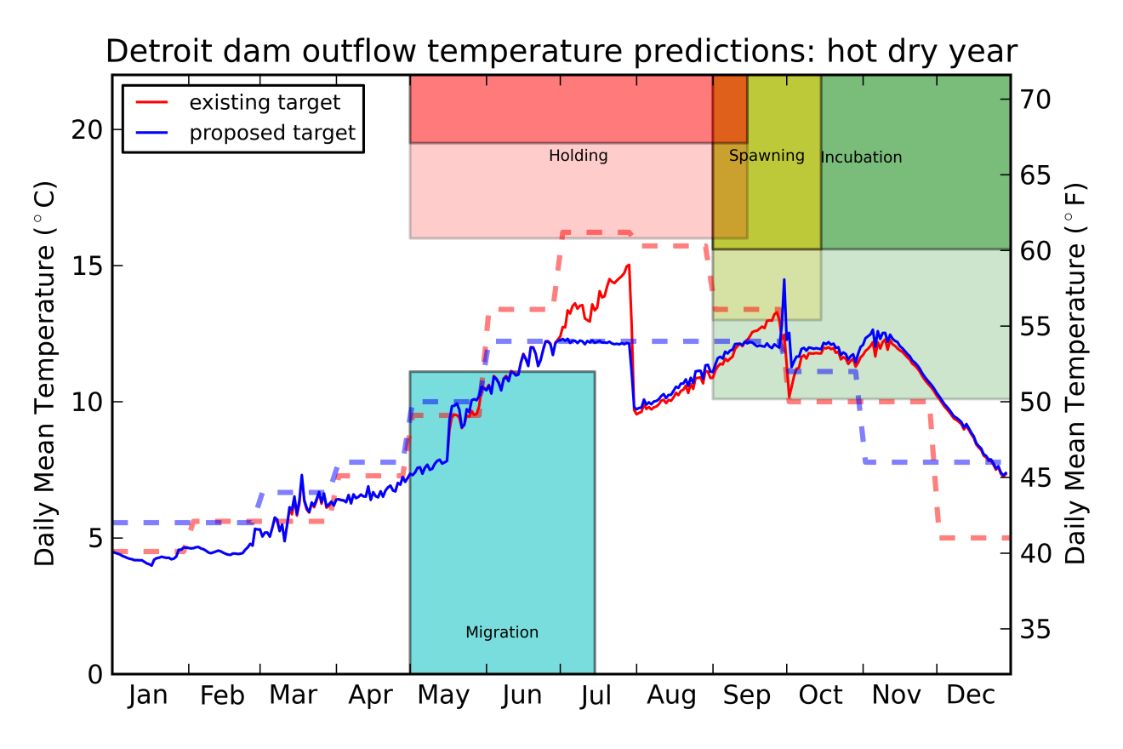
Hot Dry Year

Slide 6
Spring Chinook Evaluation
Notes:
Proposed better for spawning, worse for incubation

Slide 7
Winter Steelhead Evaluation
 |  |  |  |  | Existing |  |  |  | Proposed
Alternative Evaluation | Date Range | Impact Type | criteria (deg. C) | criteria (deg. F) | cool wet | hot Dry | normal | cool wet | hot Dry | normal
 |  |  |  |  | percent of days not achieving criteria
Incubation | Mar-01 to Jun-30 | Sub-opitimal | > 10.0 | > 50.0 | 17 | 26 | 24 | 17 | 30 | 23
Notes:
Emergence dates equal

Slide 8
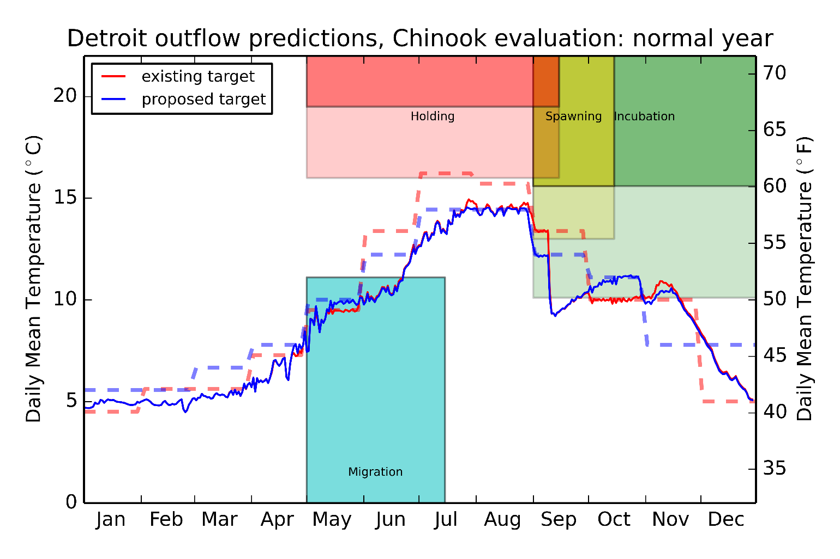
July and August Max Target (58ºF) Normal Year

Slide 9
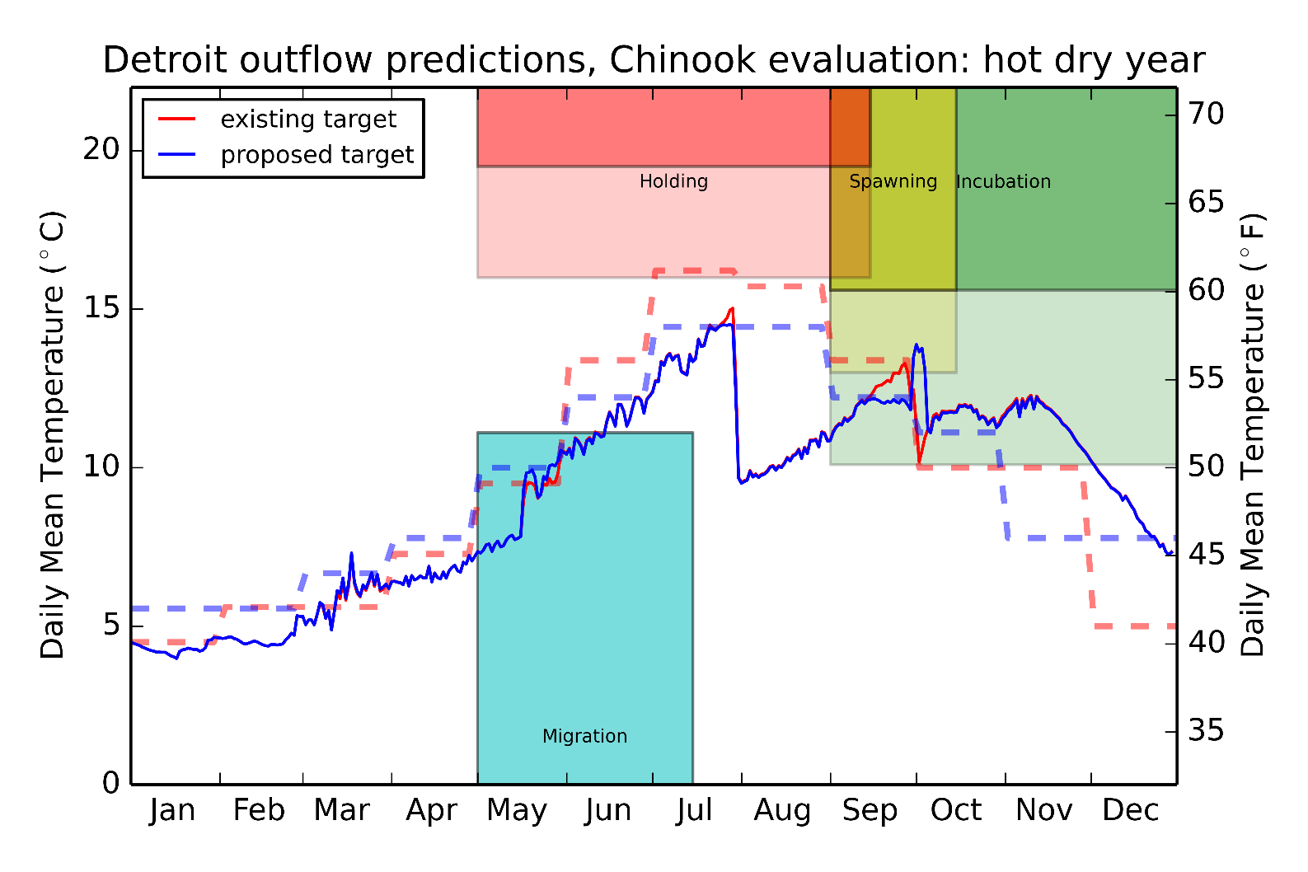
July and August Max Target (58ºF) Hot Dry Year

Slide 10
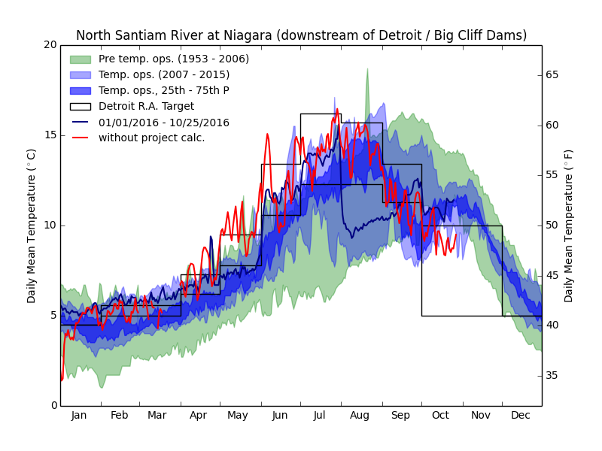
2016 Water Temperatures

Slide 11
Summary and Discussion
Proposed targets appear a little better for spawning, a little worse for incubation (ChS), differences are minimal compared to current
Proposed minimum target a concern Jun-Sep (potential migration delay, ChS)
Cooler temps better for fish health at Minto FF and in the river
Impacts between Current vs Proposed were essentially Equal for StW (very similar emergence timing)
Next Steps/Thoughts:
Vary approach depending on water year
Maybe set max target Jul-Aug 58ºF during warmer years
Use 54ºF as max target Jul-Aug (normal & cooler years)
Maybe set min target Jul-Aug between 50-52ºF (minimize potential delay)
Engage DET Temperature PDT
Bennett and Willamette counts
Meet again ???, or brief at W-FPOM
Notes:
Newer ODFW targets (cooler for July and Aug), essentially equal to current regime

